Slide 1



DEPARTMENT OF COMPUTER SCIENCE AND ENGINEERING
Major Project (COM-811) Presentation
B.Tech CSE 8th | Batch 2021-2025
PROJECT TITLE:_________________________________
Automated News Monitoring System with Department Classification
Team Members:
1. Hari Priya Dutta (2021A1R046)
2. Sia (2021A1R047)
3. Payal Totara (2021A1R145)
4. Anjali Salaria (2021A1R181)
5. Rassia Bharti (2022A1L010)
Model Institute of Engineering & Technology (Autonomous)
Notes:
Presentation slide for courses, classes, lectures et al.

Slide 2

Table of Content
Introduction
Problem Statement
Project Objectives
Proposed Solution & Innovation
Methodology (Technology Stack)
System Architecture / Workflow
Implementation
Results / Outcomes
Conclusion
References

Slide 3

Introduction
Introduction
In today’s digital era, a huge amount of news is published every day. The system uses AI Models like NLP and Machine Learning that automatically categorize news into departments like sports, politics, health, Education.
Detect Sentiment ( positive, negative or neutral )It helps in understanding trends and public opinion efficiently.
Automated systems also save time, reduce human effort, and provide real-time insights.

Slide 4
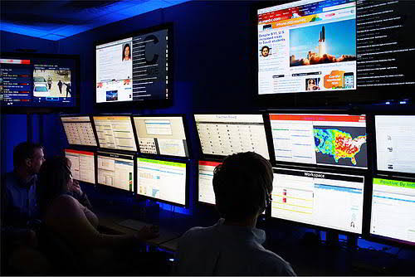
Problem Statement
Manual news monitoring is slow and inefficient.
There is no automated system to organize news articles into different departments.
It is difficult to understand public sentiment without automation.
Handling a large number of news articles is also a big challenge.
There’s a critical need for an Al-based system that performs real-time department-wise classification and sentiment analysis.

Slide 5

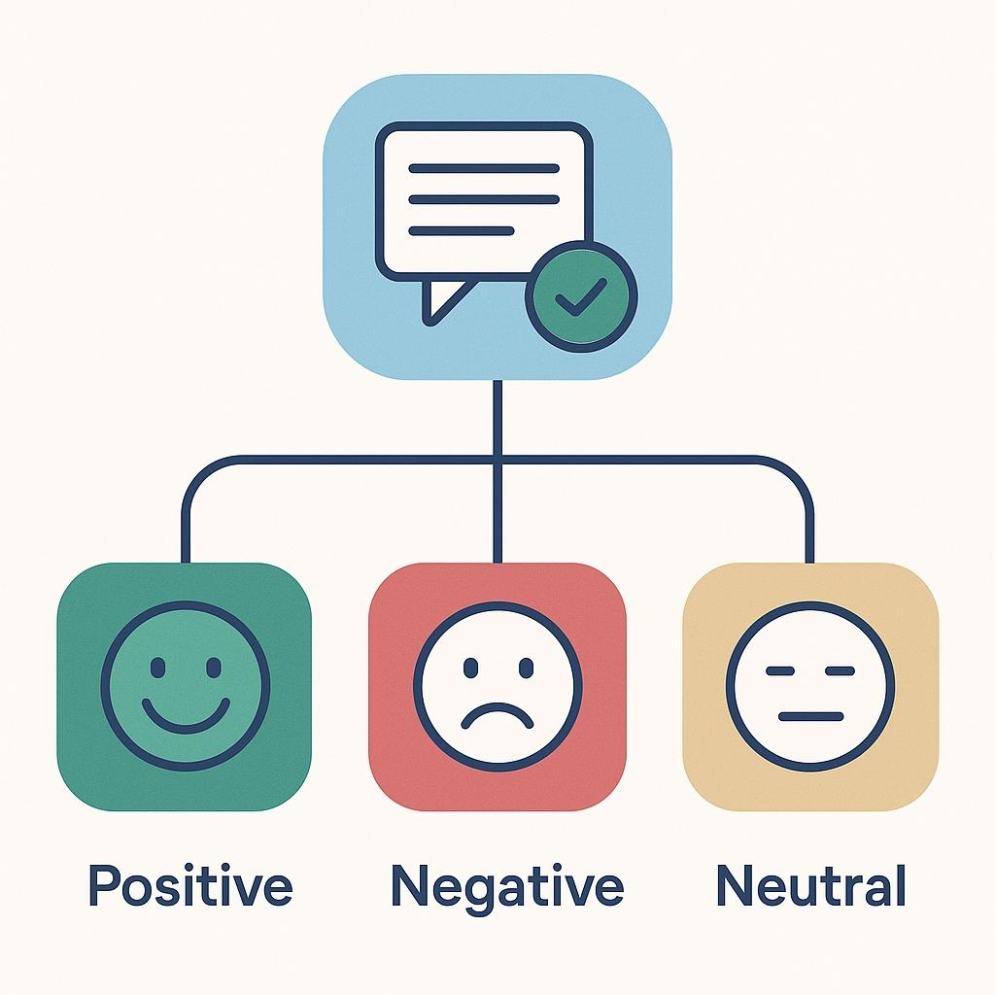
Objectives
To automatically classify news into departments like Politics, sports, Entertainment, etc.
To analyse the sentiment of news (Positive, Negative, Neutral).
To build an efficient and Scalable text classification system.
To provide visual summaries and reports for better understanding and decision-making.

Slide 6




Proposed Solution & Innovation
News Classification
Classifies news in to different departments.
Sentiment Analysis
Analyse Sentiment of news (positive, negative or neutral.
Summarization
Generating short summaries of long news articles.
Chatbot Support
Chabot support with multilingual interface can be added
For better user interaction.

Slide 7
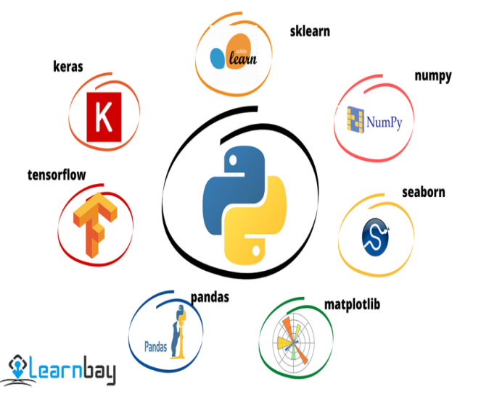
Technology Stack
Backend: Python, Google Colab
AI/ML Frameworks: PyTorch, scikit-learn, TensorFlow
ML Algorithms:
Deep Learning (Transformers, Encoders)
Machine Learning (Multinomial Naïve Bayes, Gaussian Naïve Bayes, Bernoulli Naïve Bayes, K-Neighbors Classifier, Random Forest K-means, Logistic Regression, Decision Tree Classifier, Support Vector Classifier)

Slide 8
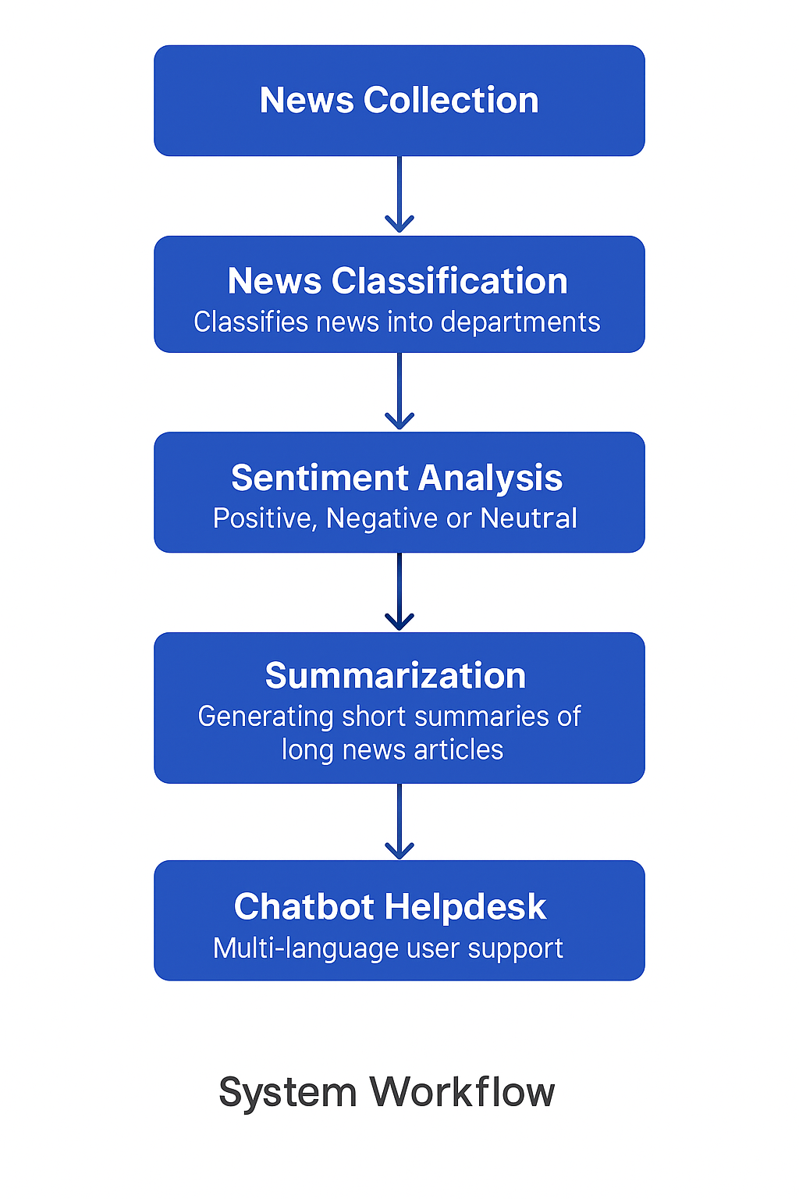
System Architecture / Workflow

Slide 9
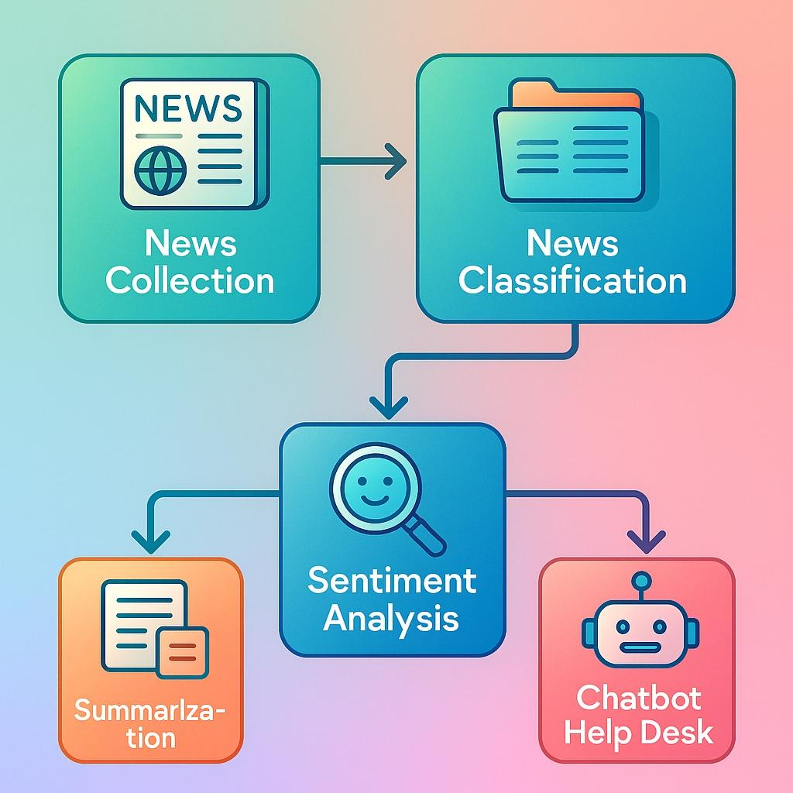
Implementation
News Collection &Classification
News classification into Categories.
Sentiment Analysis
Positive, Negative or Neutral
Summarization
Generating short summaries for news articles.
Chatbot Helpdesk
Multi-language user support

Slide 10
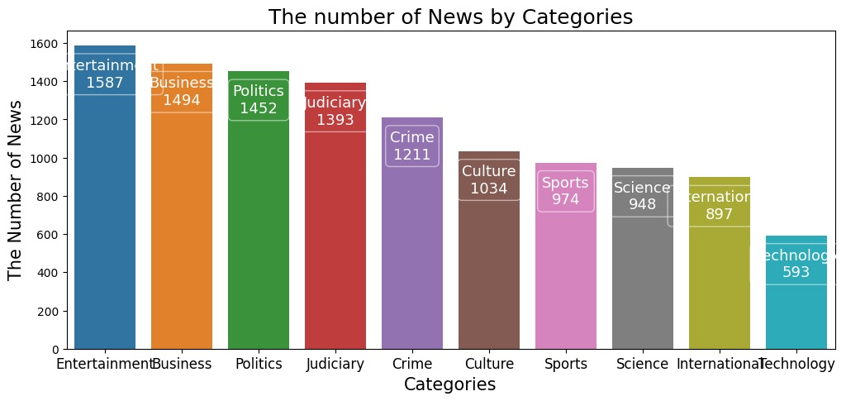
Results / Outcomes
Created visual dashboards to display department-wise.
System can handle large volumes of news data efficiently.
Project can be scaled further for real-time monitoring and multilingual support.

Slide 11
Conclusion
The automated news monitoring system effectively classifies news articles by department and analyses their sentiment.
It reduces manual effort, saves time, and improves accuracy in understanding public opinion.
The project demonstrates how machine learning and NLP can make news analysis faster, smarter, and more efficient.
It can be further improved by adding features like real-time alerts.

Slide 12
References
BBC News Dataset – Kaggle(https://www.kaggle.com/datasets/praiwan/bbc-news-classification)
Scikit-learn Documentation –(https://scikit-learn.org/stable/documentation.html
NLTK – Natural Language Toolkit(https://www.nltk.org/)
Python Official Documentation(https://docs.python.org/3/)
Research papers and blogs on Sentiment Analysis and News Classification using NLP Matplotlib & Seaborn for Visualization(https://matplotlib.org/), (https://seaborn.pydata.org/) Pandas – Data Analysis Library (https://pandas.pydata.org/)
TextBlob – Python Library for Sentiment Analysis(https://textblob.readthedocs.io/en/dev/) SpaCy – Industrial-strength NLP Library (https://spacy.io/)
Plotly – Interactive Dashboards and Charts(https://plotly.com/)

Slide 13
Thank You

